Slide 1
Servos
Lecture 5
Ⓒ 2018 ECSESS RoboElectronics Committee, Slides adapted from Dirk Dubois

Slide 2
Web Control from last week
Learned about REST and controlling the motor with a Flask web interface
Ⓒ 2018 ECSESS RoboElectronics Committee, Slides adapted from Dirk Dubois
‹#›

Slide 3
Today’s Tasks
Be able to control the robot with the button on the web interface get it working if you haven’t yet
Get the servo working
Link to starter code : https://github.com/HanYangZhao/RoboElectronics

Slide 4
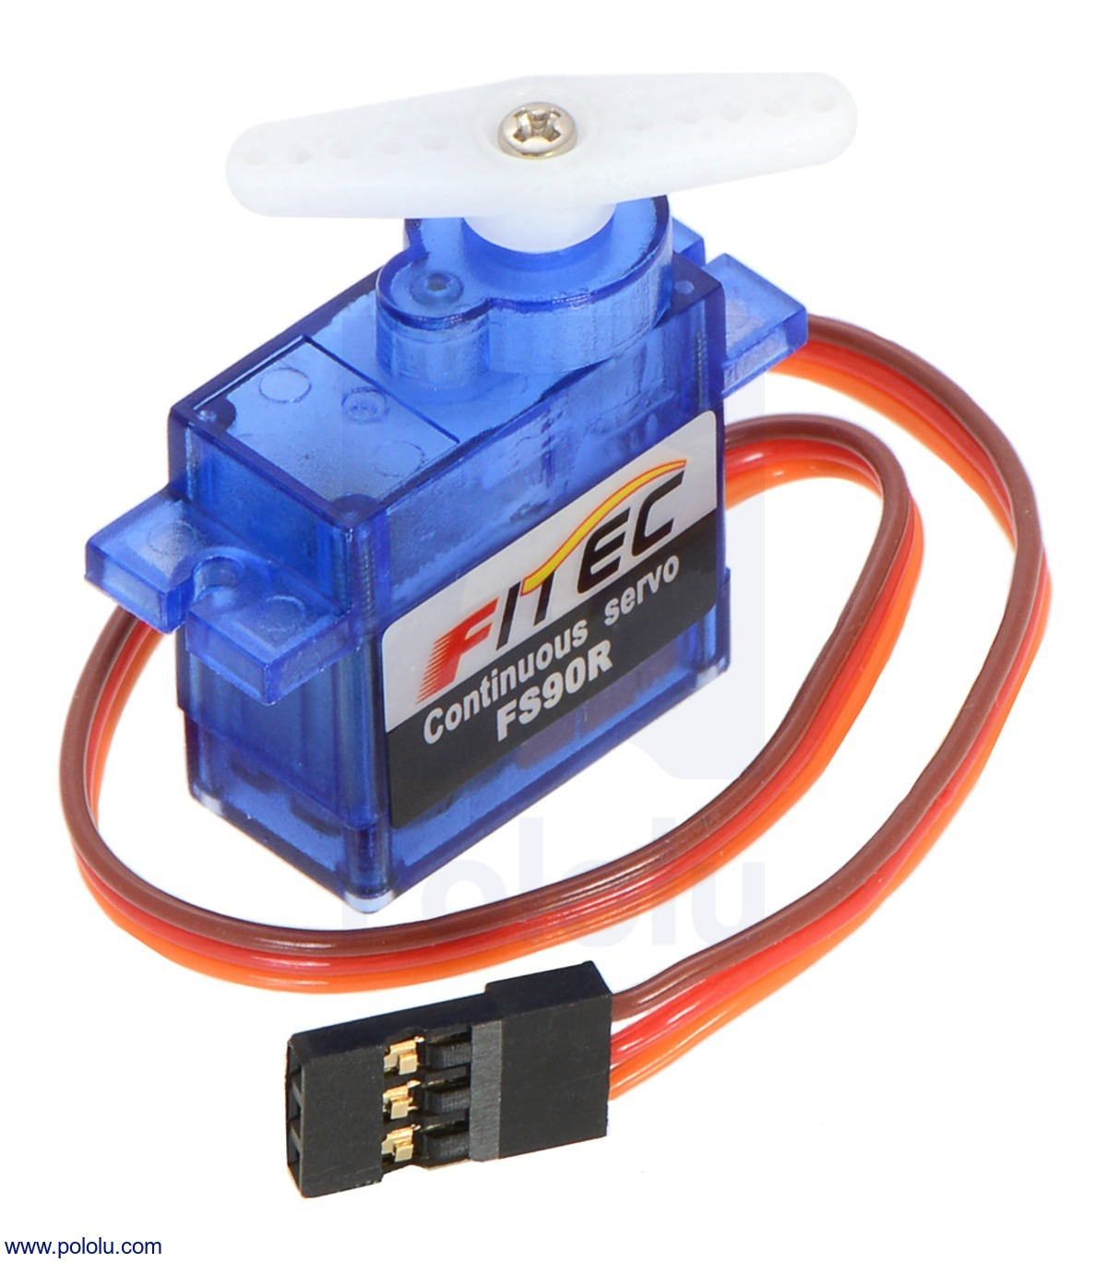
Servo Motors
Different than regular DC motors
Limited turning range (180 degrees)
Can set desired position
Turning speed is usually determined by the input voltage
Brown wire -> GND
Red wire -> 5V
Orange wire -> Control Pin

Slide 5
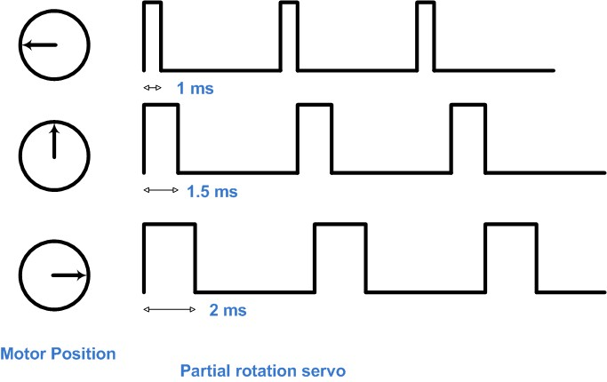
Controlling Servos
Position is controlled by a pulse signal we send on the control pin.
The pulse usually ranges from 1ms - 2ms and the period is usually 20 ms
20ms

Slide 6
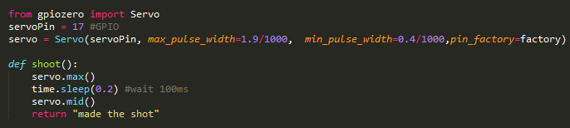
Controlling Servos
from gpiozero import Servo
servoPin = 17 #GPIO
servo = Servo(servoPin, max_pulse_width=1.9/1000, min_pulse_width=0.4/1000,pin_factory=factory)
def shoot():
servo.max()
time.sleep(0.2) #wait 100ms
servo.mid()
return "made the shot"

Slide 7
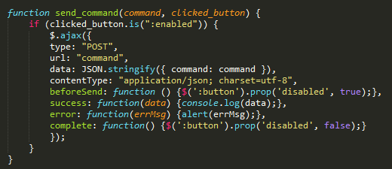

Controlling Servos
index.js
When a button is clicked, a POST request with the value of the button (‘shoot’) is sent to the backend
index.html

Slide 8
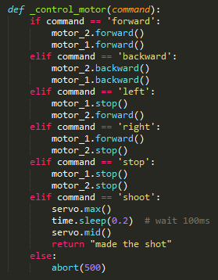
Controlling Servos
In this function, it checks if the command received (the value of the button) matches any of these cases. If the command is ‘shoot’, execute the function.
Use a number between 0-2200, this is the pulse width and sets the position of the servo
main.py
Add this under the _control_motor function in main.py

Slide 9
Today’s Tasks
Be able to control the robot with the button on the web interface by the end of the workshop
Get the motors working if you didn’t get it last time
Link to starter code : https://github.com/HanYangZhao/RoboElectronics

Slide 10
Next week
Webpage Frontend (HTML/JS)
Servo to control the shooting motion

